Slide 1
Assignment 8: Bank Holding Companies (BHC)
Glenn, Michael, Eric, Kramer, Nikitia

Slide 2

J.P. Morgan Chase & Co. (JPMC) is a global BHC comprised of four specialized business units:
Consumer & Community Banking (CCB)
Commercial Banking (CB)
Segment: Large business services.
Services: Lending, investment, and financial solutions.
Asset & Wealth Management (AWM)
Segment: High-net-worth individuals and institutional investors.
Services: Investment and wealth management services.
Segment: Individual consumers and small businesses.
Services: Personal banking, lending, and investment.
Corporate & Investment Bank (CIB)
Segment: Investment banking, market-making, and treasury services.
Services: High-end corporate and institutional clients.

Slide 3
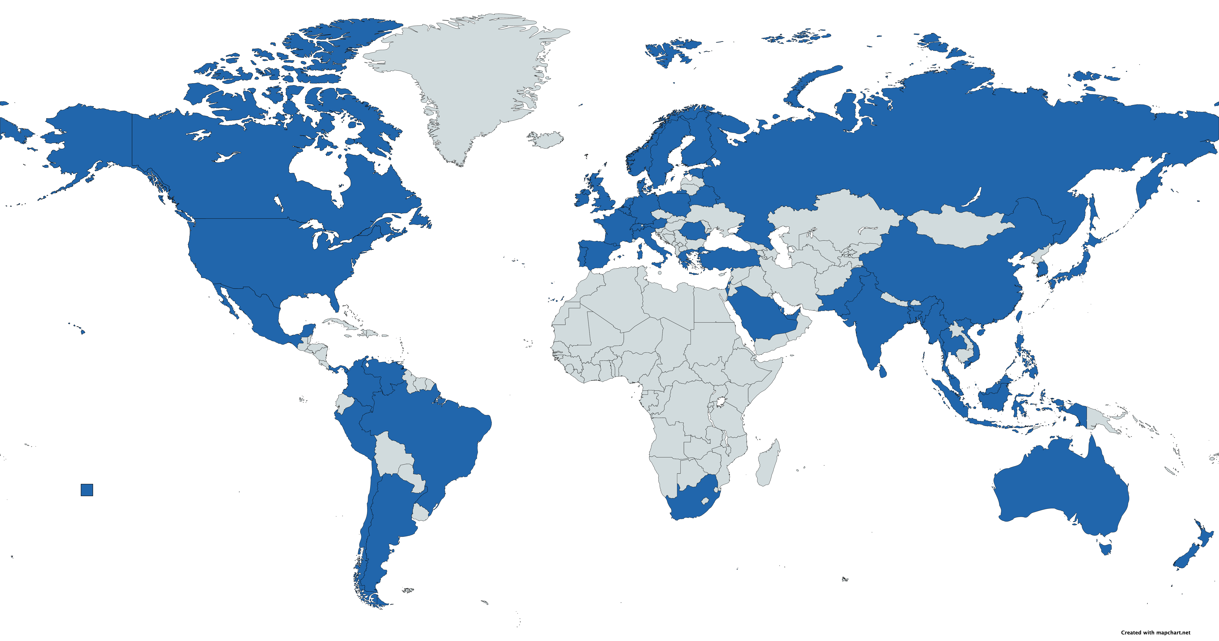
JP Morgan Chase & Co. Global Presence

Slide 4
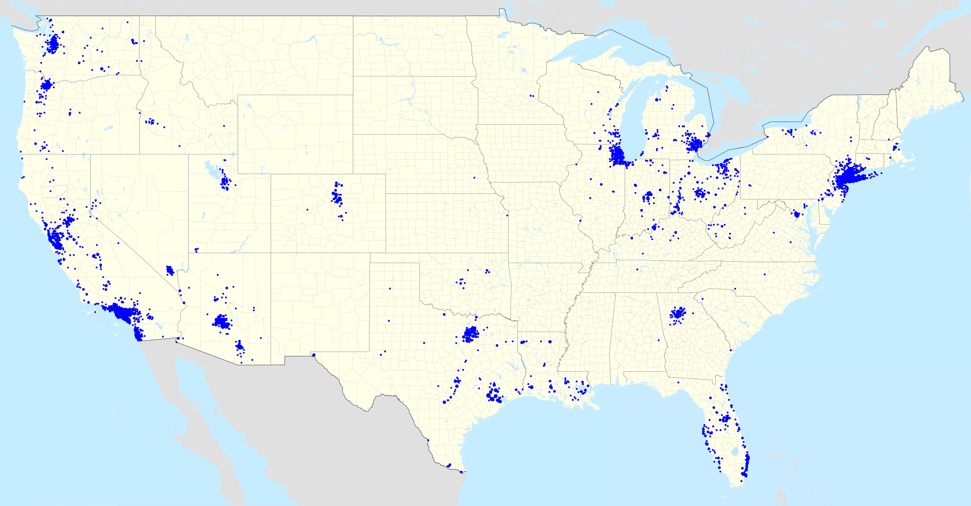
JP Morgan Chase & Co. National Presence

Slide 5
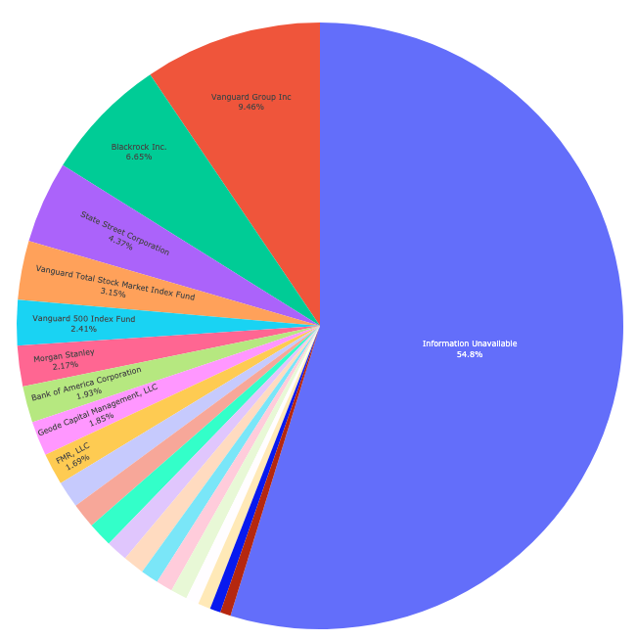
Breakdown of Ownership

Slide 6
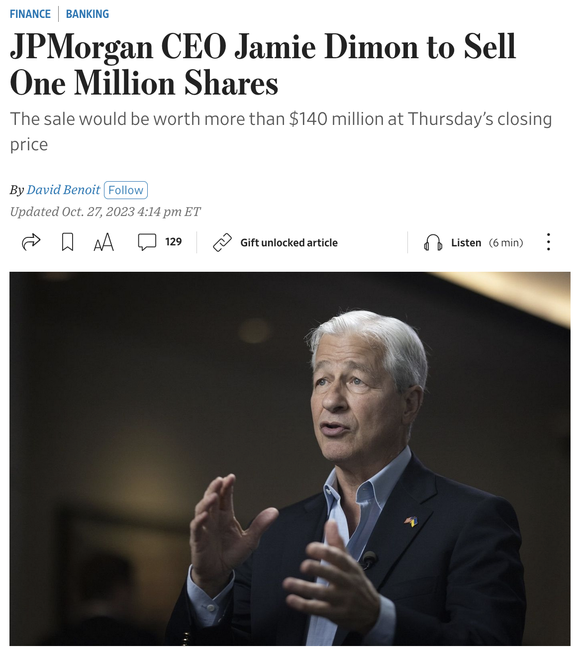
Insider Trading
For the first time in his history as CEO, Jamie Dimon sold 12% of his holdings in JPMC
Caused a 3% drop in JPMC value due to the sell-off
Bank representatives caution this is not related to the bank’s performance

Slide 7
Markets View on JPMC
Wait for nikita

Slide 8
Bank Call Reports
Wait for nikita

